Slide 1

MOLECULAR
VISUALIZER PRO
Interactive 3D Molecular Simulation & Visualization
Python • VPython
PubChem API
Real-time Simulation

Slide 2
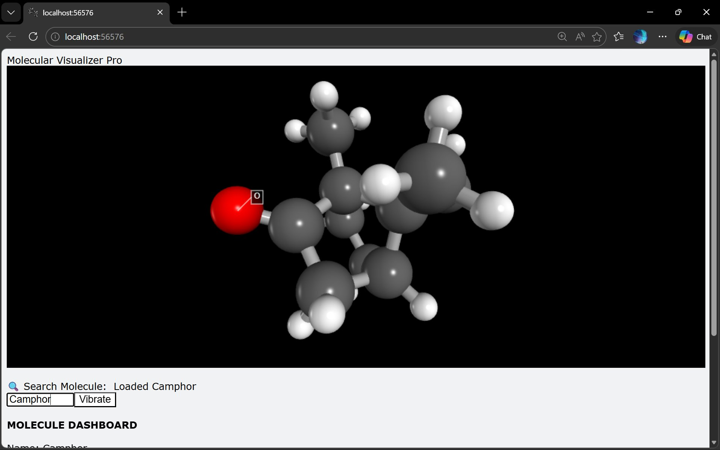
PROJECT OVERVIEW
What is Molecular Visualizer Pro?
A Python-based interactive 3D application that fetches real molecular data from PubChem, renders it live in a WebGL canvas, and simulates atomic vibration — all in under 200 lines of code.
27
28
3
Atoms (Camphor)
Bonds detected
Unique Elements
Molecular Weight: 152.23 u (Camphor — C₁₀H₁₆O)
Fig 1 — 3D view of Camphor with O atom label

Slide 3






KEY FEATURES
3D Ball & Stick Rendering
Live PubChem Search
Vibration Simulation
Atoms as spheres, bonds as cylinders — color-coded by element (O=red, C=grey, H=white)
Type any molecule name and fetch real XYZ coordinates instantly via REST API
Sinusoidal displacement along radial axis at 10 Hz, 0.05 Å amplitude, toggle on/off
Double-Click Labels
Auto Bond Detection
Live Dashboard
Double-click any atom to display its element symbol as an inline annotation
Euclidean distance threshold < 1.6 Å auto-generates all bond cylinders
Real-time formula, MW, atom count, bonds, dominant element & composition

Slide 4
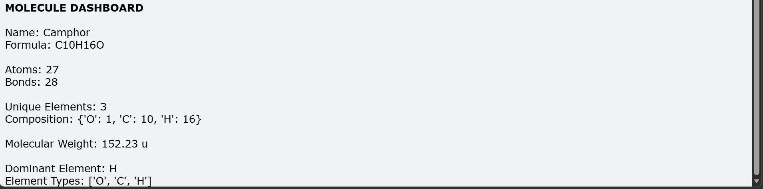
DEMO RESULTS — CAMPHOR
Name
Camphor
Formula
C₁₀H₁₆O
Atoms
27
Bonds
28
Fig 2 — Auto-generated Molecule Dashboard
Unique Elements
3
Mol. Weight
152.23 u
C
O
H
Dominant Element
Hydrogen (H)
Carbon
Oxygen
Hydrogen
Atomic Composition

Slide 5


TECHNICAL ARCHITECTURE
PubChem API
XYZ Parser
Atom/Bond
VPython 3D
SDF 3D endpoint
Coordinate extraction
Object model
WebGL canvas render
Rendering Engine
Bond Detection
VPython (Visual Python) — browser-native WebGL 3D canvas
Euclidean distance < 1.6 Å between any pair of atoms
Vibration Model
Event Handling
Radial sinusoidal: pos = base + dir × sin(t × 10) × 0.05
scene.bind('click') — double-click threshold 0.3s
UI Controls
Data Format
winput (search), wtext (dashboard), button (toggle)
PubChem SDF → XYZ coordinate parsing → Atom objects

Slide 6
HOW IT WORKS
01
Search & Fetch
02
Parse XYZ
User types molecule name → urllib fetches 3D SDF from PubChem REST API at /compound/name/{name}/SDF?record_type=3d
SDF lines are split to extract atom symbol + x,y,z coordinates. Atom objects store base_pos and drive sphere meshes.
03
Detect Bonds
04
Simulate
All atom pairs compared with np.linalg.norm(). Pairs < 1.6 Å apart get a Bond object (VPython cylinder) between them.
Each frame: displacement = direction × sin(time×10) × 0.05. Atoms and bonds update at 60 fps via rate(60) loop.

Slide 7
CONCLUSION
Molecular Visualizer Pro — A complete chemistry learning tool
Fetches real 3D molecular data from PubChem for any compound by name
Renders interactive ball-and-stick models using VPython / WebGL
Auto-detects bonds via distance threshold — no manual input needed
Simulates atomic vibration with physically-inspired sinusoidal motion
Displays a live dashboard: formula, MW, composition, dominant element
Under 200 lines of Python — highly readable and extensible

